Slide 1
4.05 Remember the structures of the reproductive system

Slide 2
4.05 Remember the structures of the reproductive system
Essential question
What are the structures of the
reproductive system?

Slide 3
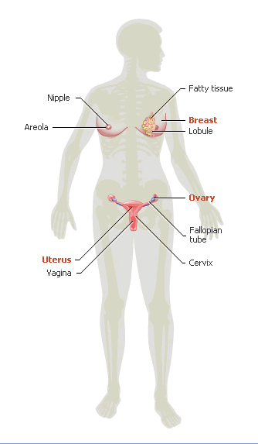
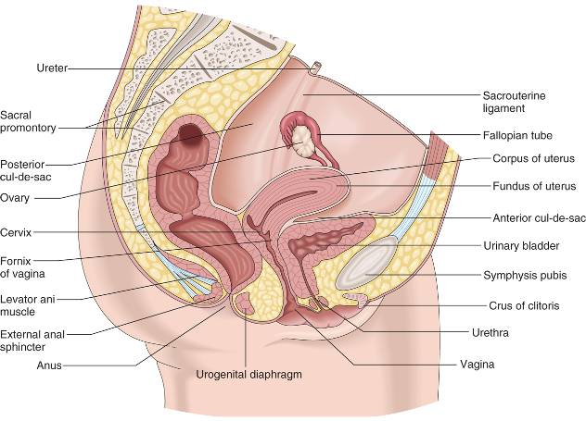
Structures of the female reproductive system

Slide 4
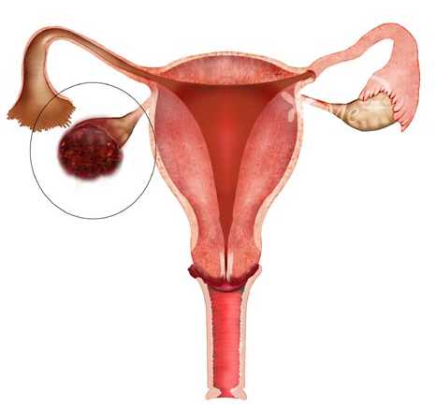
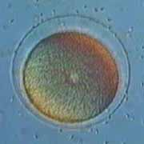
Structures of the female reproductive system
Ovary (female gonad)
Located in the pelvic cavity
About the size of an almond
Each ovary contains thousands of microscopic sacs
Ova
Known as the female gamete or Graafian follicle
The ovum is the largest cell in the human body.

Slide 5
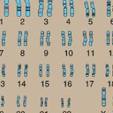
Structures of the female reproductive system
Female gametes have
22 pairs of autosomes and single pair of sex chromosomes – XX
Did you know???
What makes a person a girl instead of a boy???

Slide 6
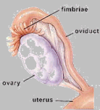
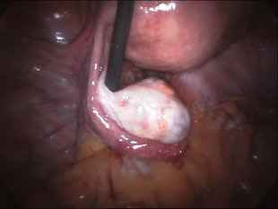
Structures of the female reproductive system
Fallopian tube
Also known as oviduct or uterine tube
Approximately 4” long
Not attached to the ovaries

Slide 7
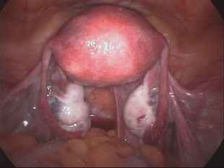
Structures of the female reproductive system
Uterus
Hollow, thick-walled, pear-shaped, highly muscular organ
Lies behind the urinary bladder and in front of the rectum

Slide 8
Structures of the female reproductive system
Uterus
Fundus
Bulging upper part of the uterus
Body
The body is the middle portion
Cervix
The narrow portion that extends into the vagina

Slide 9
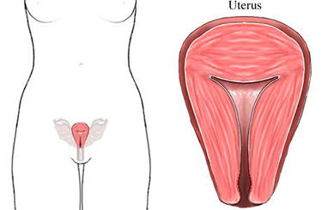
Structures of the female reproductive system
Uterus
Perimetrium (visceral peritoneum)
Myometrium
Endometrium
Perimetrium
Myometrium
Endometrium

Slide 10
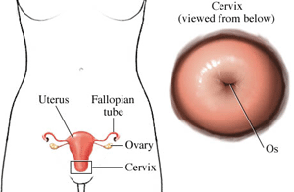
Structures of the female reproductive system
Cervix
The cervix is the lower end of the uterus
Located at the top of the vagina
Approximately one inch long

Slide 11
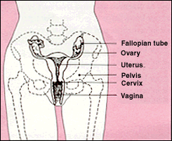
Structures of the female reproductive system
Vagina
Smooth muscle with a mucous membrane lining
Approximately 10 centimeters long
Also known as the birth canal
Hymen
External opening of the vagina may be covered by a perforated membrane

Slide 12
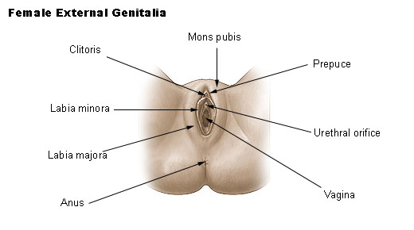
Structures of the female reproductive system
External genitalia
Vulva
External organs of reproduction
Labia
Folds of skin that surround the vagina
Labia majora
Labia minora

Slide 13
Structures of the female reproductive system
External genitalia
Clitoris
Erectile tissue
Perineum
Area between the vagina and rectum

Slide 14
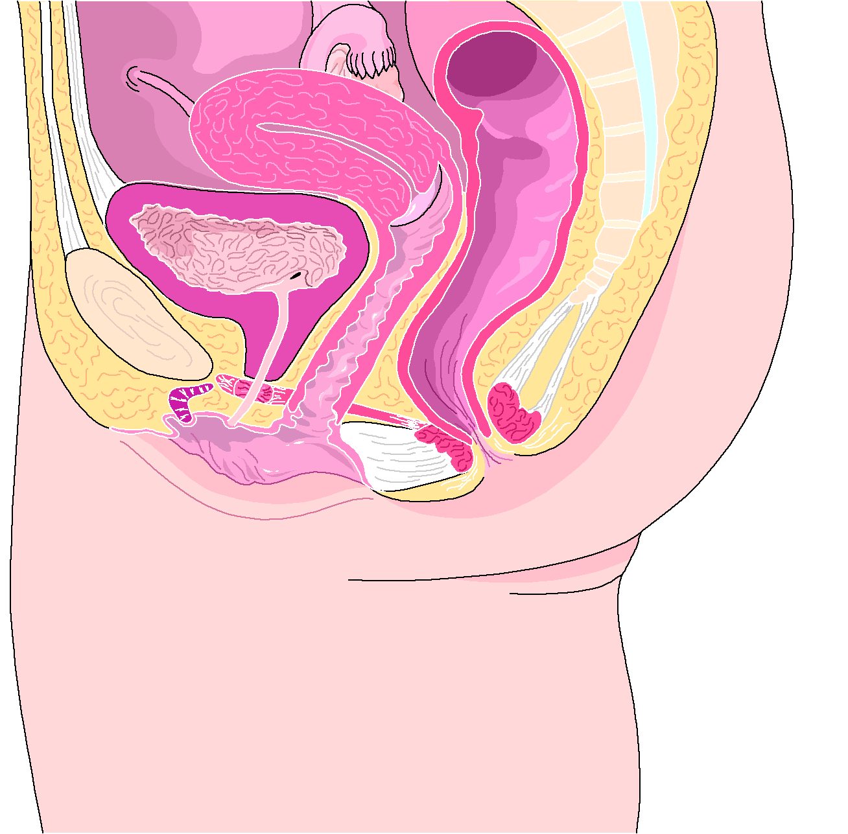
Structures of the female reproductive system
Check your knowledge...
Ovary
Fallopian tube
Uterus
Clitoris
Cervix
Vagina

Slide 15
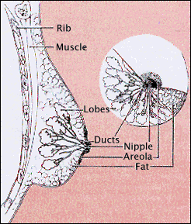
Structures of the female reproductive system
Mammary glands (breasts)
Consists of 15 or 20 lobes of granular and adipose tissue
Areola
Darkened area that surrounds the nipple

Slide 16
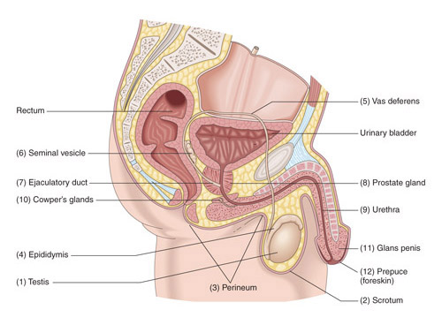
Structures of the male reproductive system

Slide 17
Structures of the male reproductive system
Scrotum
Sac of skin that contains the testes

Slide 18
Structures of the male reproductive system
Testes (two)
Primary reproductive organ
About the size of an egg
Seminiferous tubules
Each testis contains 1-4 minute, convoluted tubules
Epididymis
Coiled duct on the posterior and lateral part of the testes

Slide 19
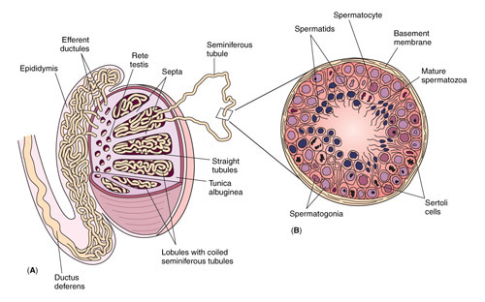
Structures of the male reproductive system
Sperm
The male gamete
Smallest cell in the human body.

Slide 20
Structures of the male reproductive system
Reproductive system of ducts
Vas deferens
-45cm structure which connects the epididymis to the ejaculatory duct
Seminal vesicles
-produces secretions that provide nutrients and protection to sperm upon ejaculation
Ejaculatory duct

Slide 21
Structures of the male reproductive system
Urethra
Connects to reproductive system of ducts
Passage way for urine and sperm
Prostate gland
Surrounds the distal of the urethra
Bulbourethral glands
Located on either side and below the prostate

Slide 22
Structures of the male reproductive system
Penis
Erectile tissue
Prepuce (foreskin)
Covers the tip of the penis

Slide 23
4.05 Remember the structures of the reproductive system
Essential question
What are the structures of the
reproductive system?

